Slide 1

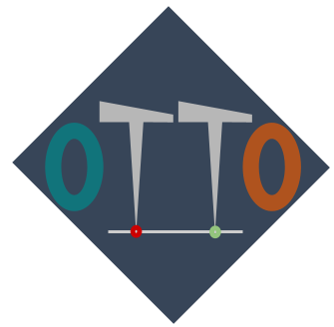
Electrical Prober
Software
Overview
Abdullah Ahmed

Slide 2
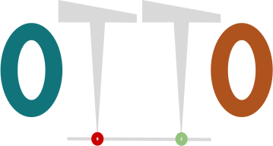

BACKGROUND
Why This Project Exists
▸ Programs are no longer compatible with new operating systems and drivers.
▸ Licenses are expensive, need for a transition to open source software
▸ Our old system was hardcoded and not configurable or transparent.
2

Slide 3

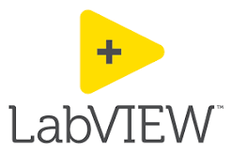
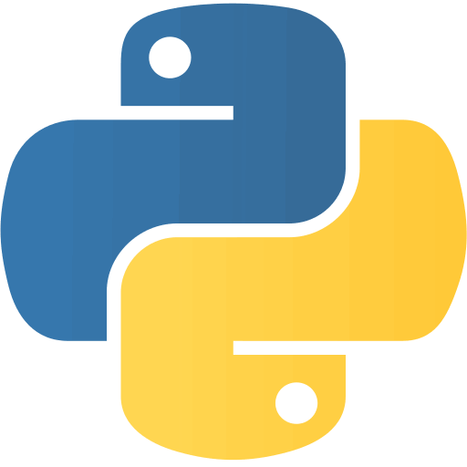

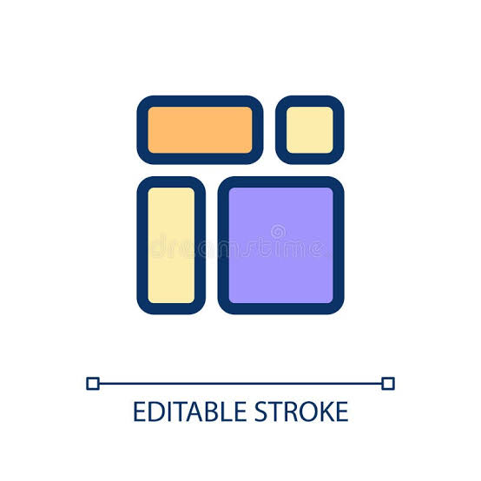
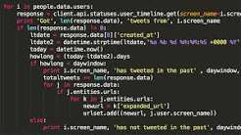
BACKGROUND
What this Software Accomplishes
▸ Allow for windows 10 and up compatibility with GPIB.
▸ Transition from Labview/VB to Python
▸ Allow for configurability, recipe creation, flexibility
2

Slide 4
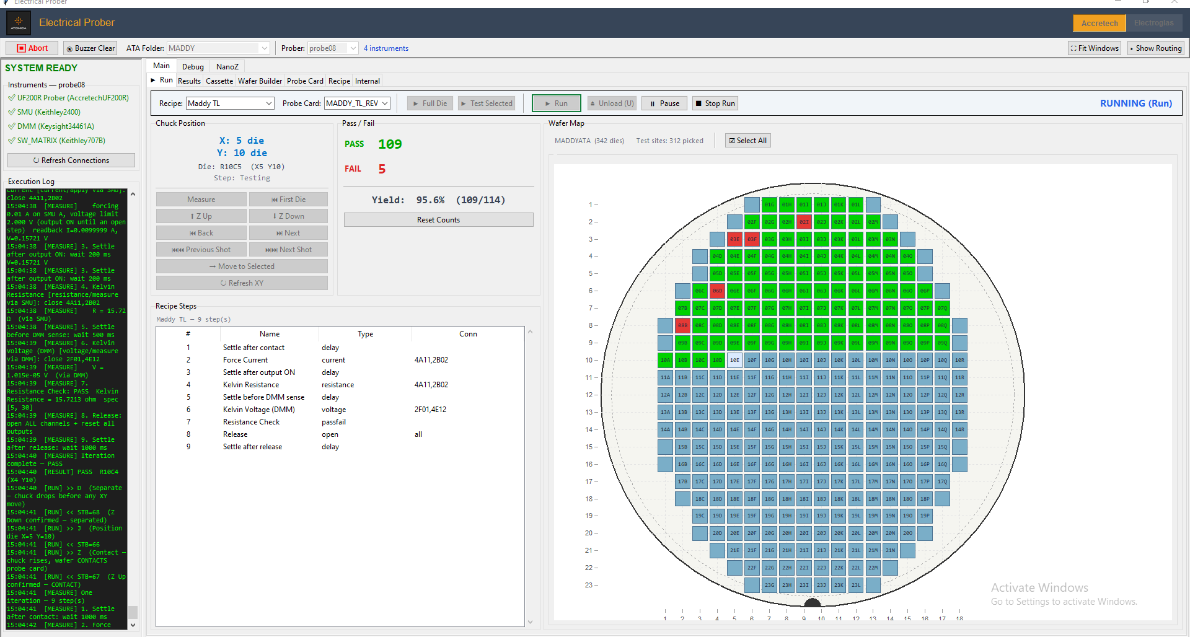
OVERVIEW
First Look
Live view — position, pass/fail, and yield update in real time
3

Slide 5
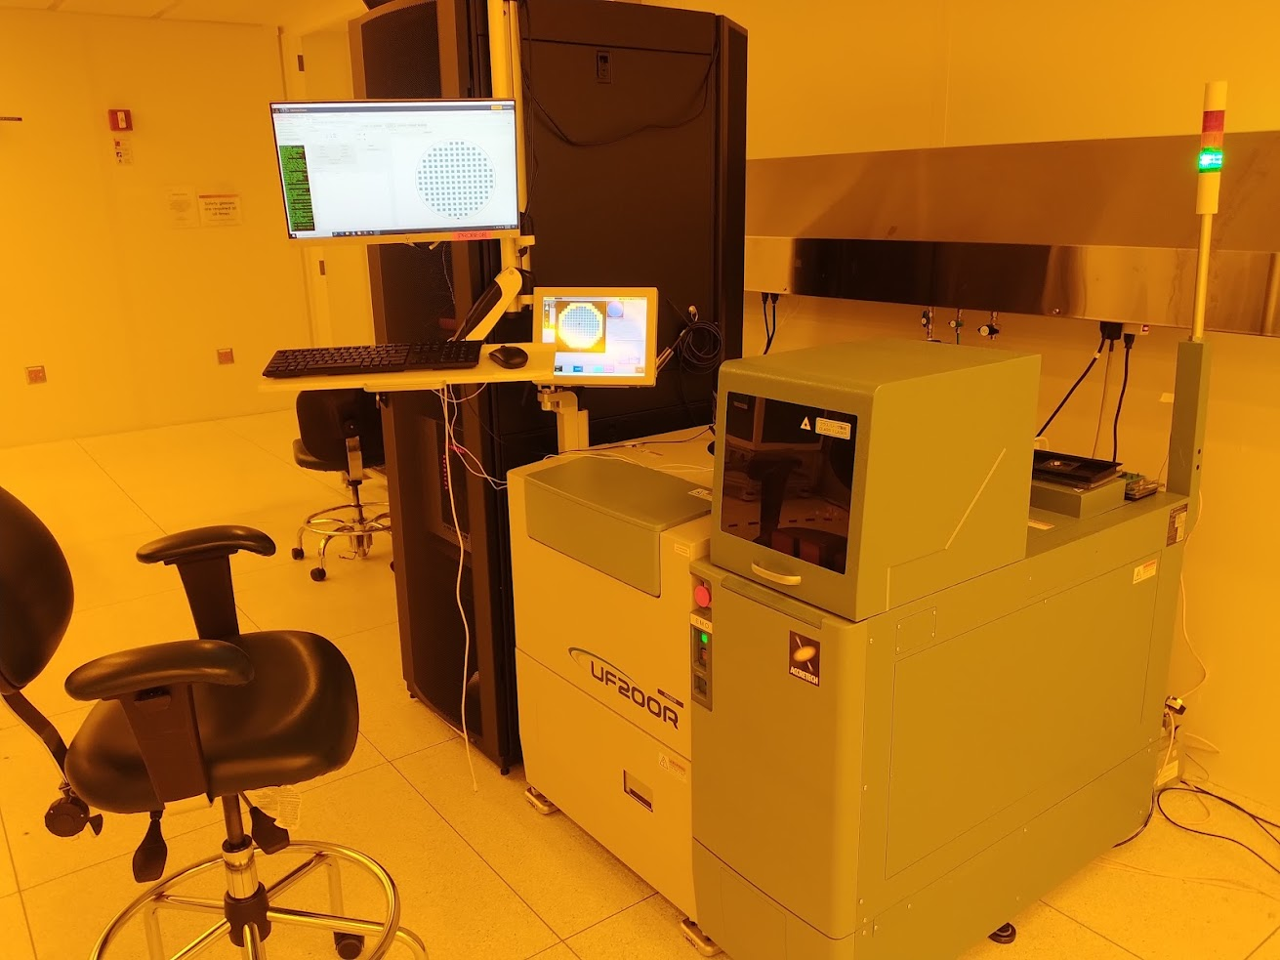
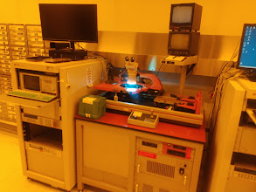
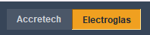
MODERNIZING THE BENCH
One Program, Any Machine
4

Slide 6
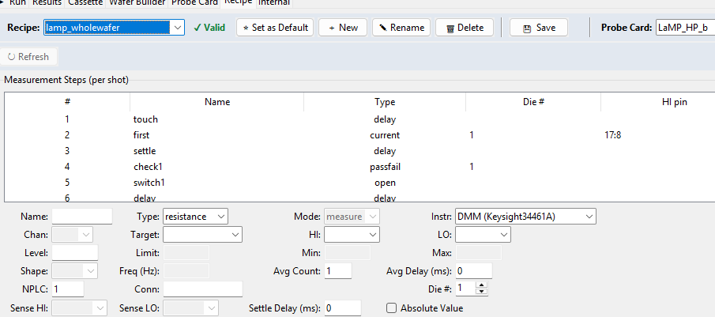
A DIFFERENT PHILOSOPHY
Ease of Use
Simple recipe creation
Communication with multiple instruments
Compatibility with any complexity probe card or system
Building a test recipe on screen — no code required
5

Slide 7
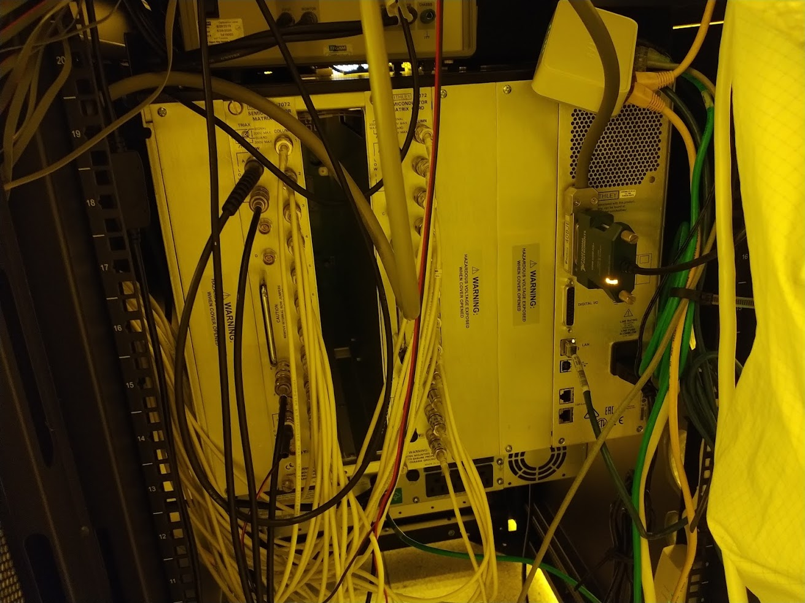
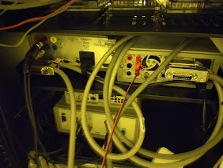
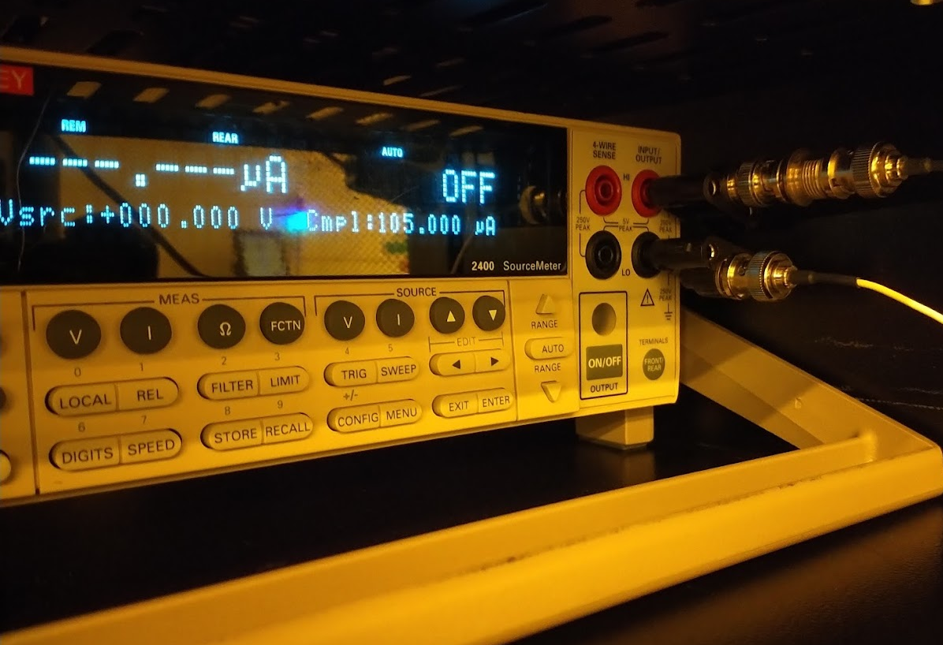
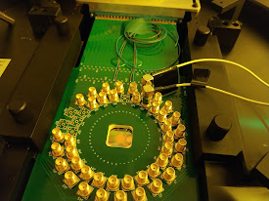
CONNECTING THE LAB
One Language for Every Hardware
Switch
GPIB Bus
Equipment
Probe Card
6

Slide 8
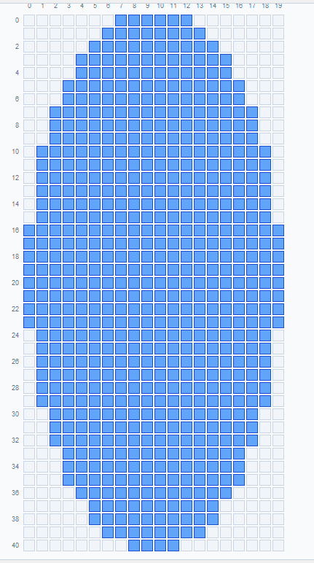
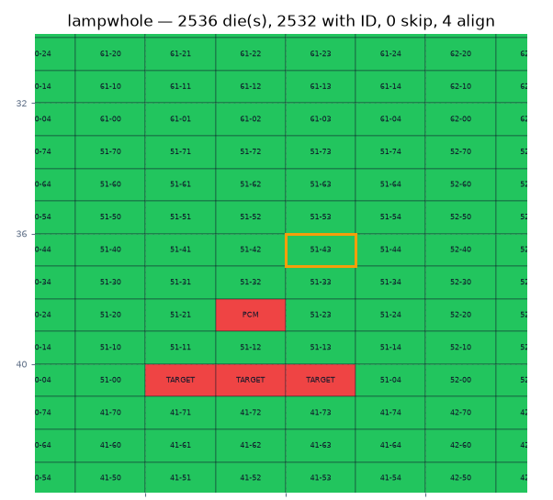
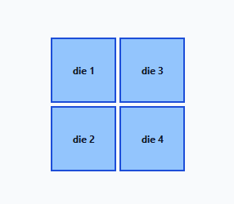
THE CORE IDEA
The Wafer Map Builder: The Foundation
7

Slide 9
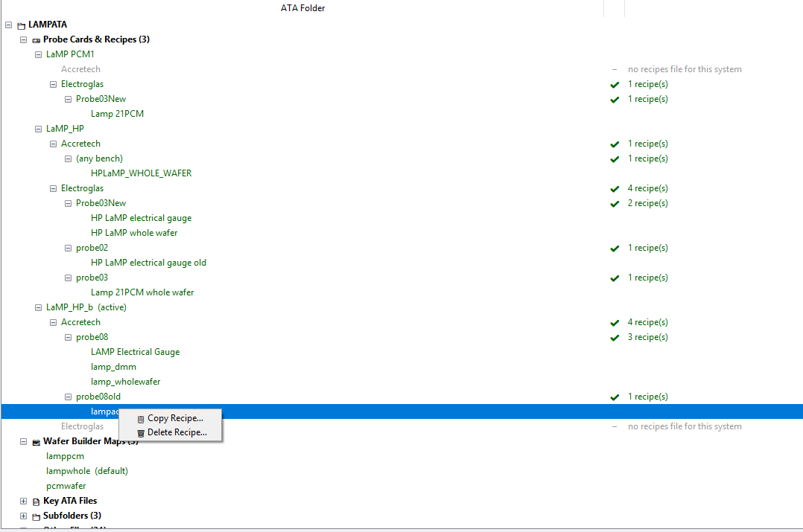
THE CORE IDEA
Flexible and Multi Bench System
7

Slide 10
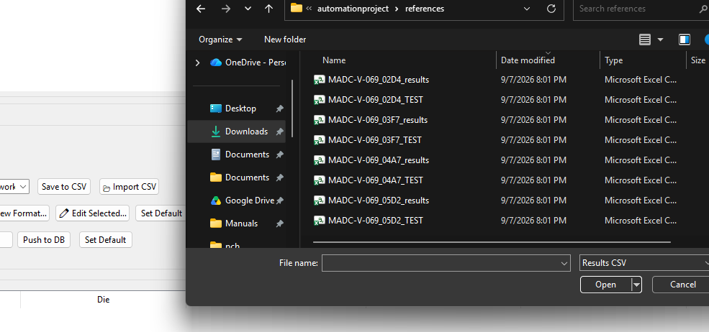
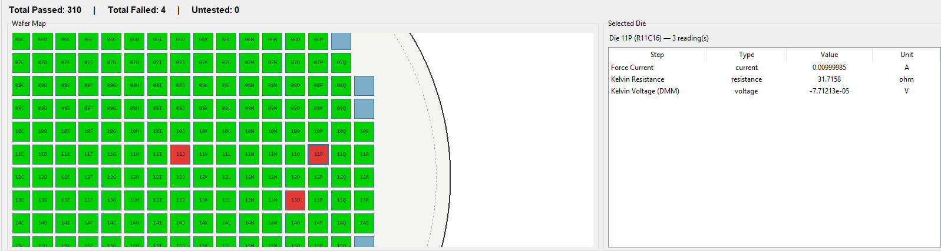
THE CORE IDEA, CONTINUED
Visuals and Data Analysis
View Data long after the run or on any computer!
8

Slide 11
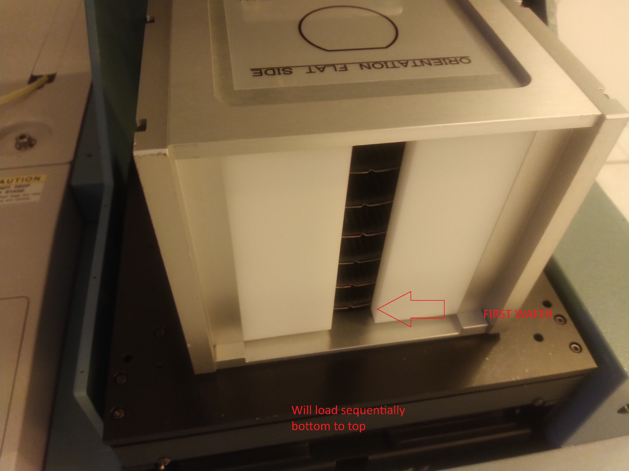
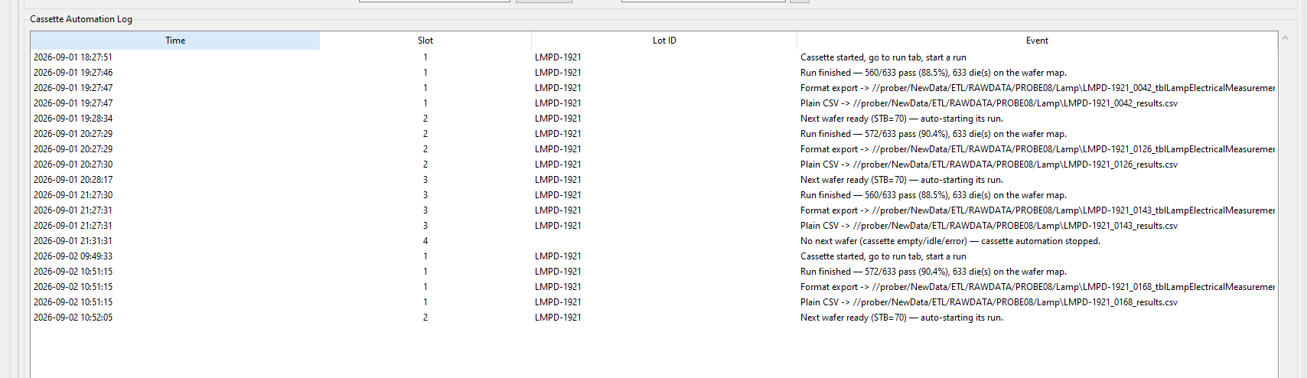
UNATTENDED OPERATION
Cassette Automation!
10

Slide 12
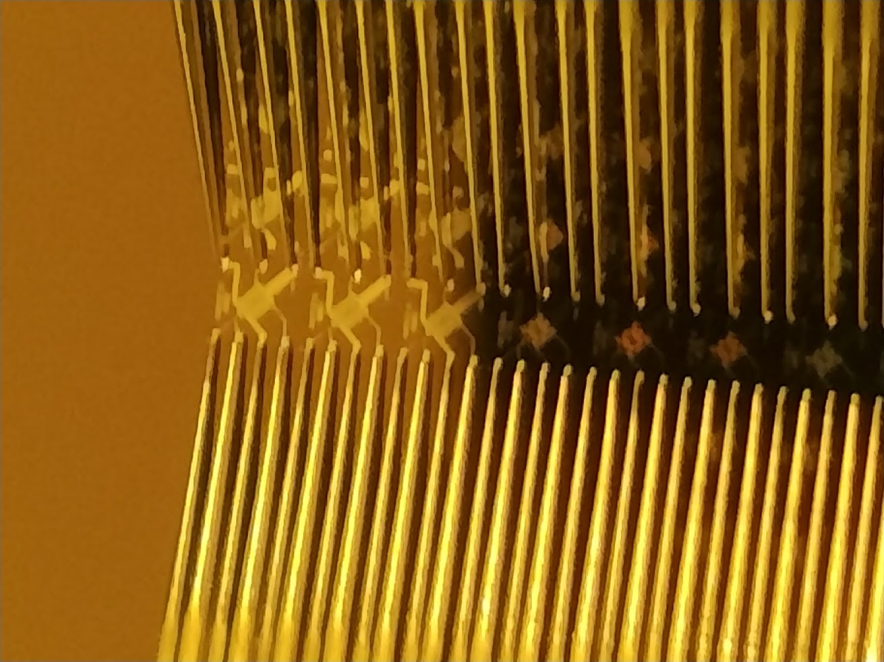
LOOKING AHEAD
Projects Improved so Far
Lamp, Cenfire, Maddy, Peanut, and Nautilus
13

Slide 13
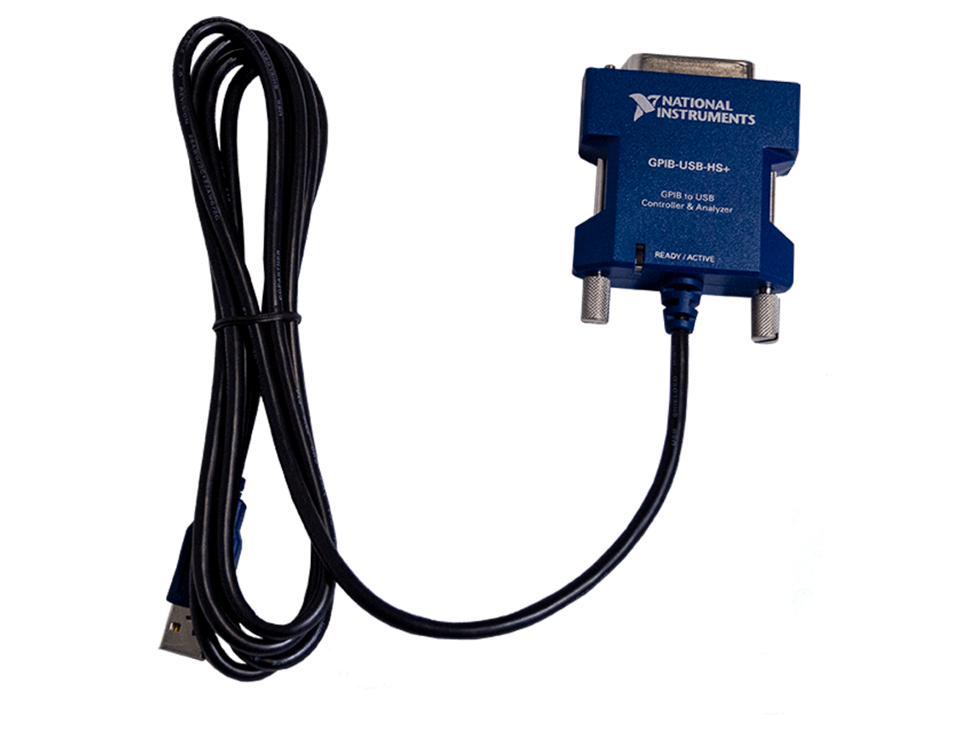
LOOKING AHEAD
Main Takeaways
Equipment using GPIB does not have to be an obstacle.
My software can be a basis for many automation projects, not just probing.
Simplify, consolidate, and futureproof process flows.
Starting a new project can now take a few days instead of weeks.
13

Slide 14
Same hardware. Modern, configurable software.
Questions?
14

